Slide 1

Introduction to
Git & Github
Notes:
Welcome address

Slide 2

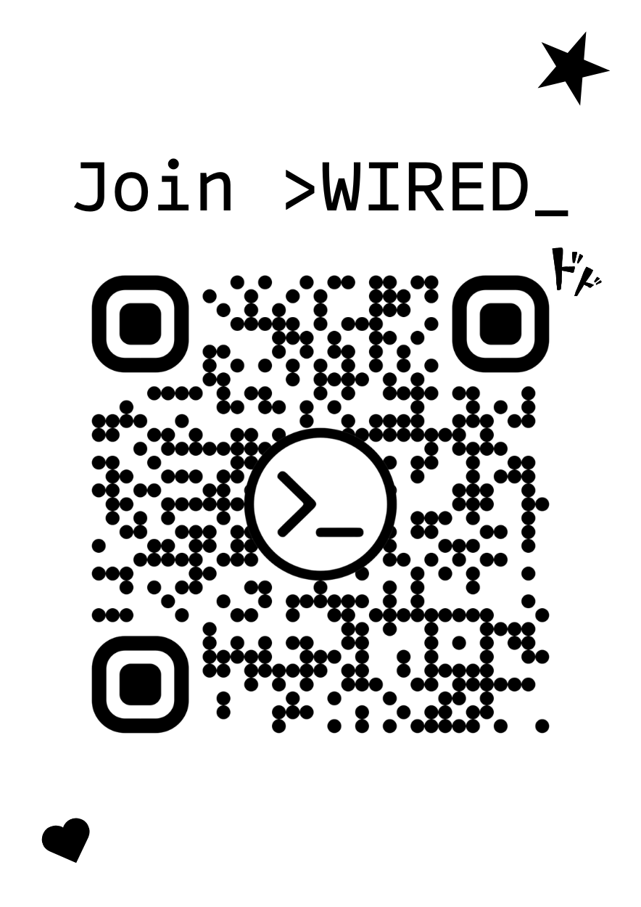


Who are we?
Notes:
What is WIRED
Who am I
Get committee and directors to intro themselves

Slide 3

Workshop objectives
Understand version control & git
Learn common and key git commands
Use Github for collaboration
Hands-on practice

Slide 4
Why version control?
Notes:
Give anecdote
For example: you’re working on a project, you end up losing hours of progress when I accidentally deleted a key section of code. I was making several changes to a script to improve performance, and without a version control system like Git, I had no way to revert to a previous state once things went wrong.
Think about it as a safety net that enables experimentation without fear. With Git, I can branch out to try new ideas, and if something doesn't work, I can easily roll back to a stable version.
This experience underscored the importance of version control as an essential tool for both collaboration and individual productivity.

Slide 5

What is Git?
Distributed Version Control System (DVCS)
Tracks changes in files over time
Helps developers collaborate on code efficiently
Key Features of Git
Local & Distributed
Work offline, sync when needed
Fast & Lightweight
Optimized for speed and efficiency
Branching & Merging
Work on multiple features simultaneously
Notes:
Version control software - helps track changes in your code

Slide 6

What is Github?
Cloud-based platform for hosting git repositories
Built on top of Git for collaboration and project management
Enables team code collaboration
Key Features of Github
Remote Repository Hosting Store and manage Git repositories online
Collaboration Tools
Pull requests, code reviews, and issues
Version Control
Track changes and manage project history
Notes:
Imagine you're working on a group project with friends to write a book. Instead of emailing different versions of the document back and forth (which gets messy fast), you use a shared online platform where everyone can contribute, track changes, and even go back to previous versions if needed.
Website building - allows multiple components to be built simultaneously

Slide 7
Git workflow
Git state
File state
(Local) Working repository
Staging area
Local repository (.git folder)
Remote repository
git add <file>
git commit (-m “ ”)
git push
git reset HEAD <file>
git reset --soft HEAD~1
git clone
git restore –staged <file>
git pull
git reset (--mixed) HEAD~1
git reset --hard HEAD~1 (deletes changes)
Untracked, modified
Staged
Committed
Pushed
Notes:
What is Git state vs file state
HEAD - latest commit on the current branch
File State refers to the actual files on your computer. When you edit, add, or delete files, you're changing the file state.
Git State refers to how Git tracks those files. A file can be:
Let's discuss what a repository is first: Project folder that Git tracks. It stores all the files, directories, and history of changes made to a project. Think of it as a snapshot manager that records every modification you make, allowing you to revisit, undo, or collaborate on changes efficiently.
HEAD~1 refers to the commit before the current commit (i.e., one commit behind HEAD).
Local working repo: Folder where the hidden .git folder is located. It is the project folder where you run the git init command or the folder you cloned from GitHub or Git Lab. Only the files inside the project folder can be tracked by git. And any file inside this directory can be tracked, no matter if it is in a subdirectory or not.
Staging area: Staging area is a virtual git state, files in the staging area have been tracked by git and are ready to be committed to the local repo. Think of it like a "draft" where you prepare changes before committing.
Local repo: Local repo is also a virtual git state, normally it refers to the hidden .git folder. This folder handles all the magic heavy lifting work of git. However, the files in the git folder have been treated specially and are not human readable. So don't bother to find your files there. However, if you make some commits, you will find that the size of the git folder would increase, reflecting that your file changes have been tracked by git.
Remote repo: Copy of your local repository that lives on a server. It allows multiple people to collaborate on the same project. You interact with it using git push (to send changes) and git pull (to receive updates).
File state: Due to the different Git states, there are multiple states for the files in the project folder. The first of which is the untracked/modified state, files here are either untracked (not yet added to Git) or modified (changed since the last commit).
Once a file is added by git, it's first in the staging area and thus in the staged state, meaning that it's ready to be committed to the local repo.
When a change is committed, the file is then in the committed state, which means that the staged file has been added to the local repo and can be pushed to the remote repo.
If we make changes to a file that has already been tracked, then the changes are first in the modified state in the local working directory, we need to add and commit the changes in order to track them in git.
Finally, the commits in the local repo can be pushed to the remote repo, which will then make our remote repo up to date with the local repo.

Slide 8
Let’s do some practice
Create a github account
https://github.com/signup
Go to
https://github.com/AlZ11/WIRED-Git-Workshop
Click the green code button Create codespace on main
Notes:
Keeping it simple today normally you would need to install git manually and run it thru an IDE

Slide 9
Demo

Slide 10
Branching
Allowing multiple people (or even a single developer) to work on different features or fixes in parallel without affecting the main project. Merging brings these changes together into a single, unified history.
Notes:
Branch: Separate workspace that allows you to develop features, fix bugs, or experiment without affecting the main codebase.
*Give anecdote
By default, Git has a main branch (often called main or master), and all development starts there unless a new branch is created.

Slide 11
Branching commands
git branch <branch_name>
git branch
Git checkout <branch_name>
checkout -b <branch-name>
git checkout main → git merge <branch_name>
git branch -d <branch_name>
git branch -D <branch_name>
git checkout <branch_name> → git rebase main
Create a new branch
List all branches
Switch to a new branch
Create & switch to new branch
Merge branch into main
Delete a branch
Delete a branch forcefully
Rebase a branch onto main

Slide 12
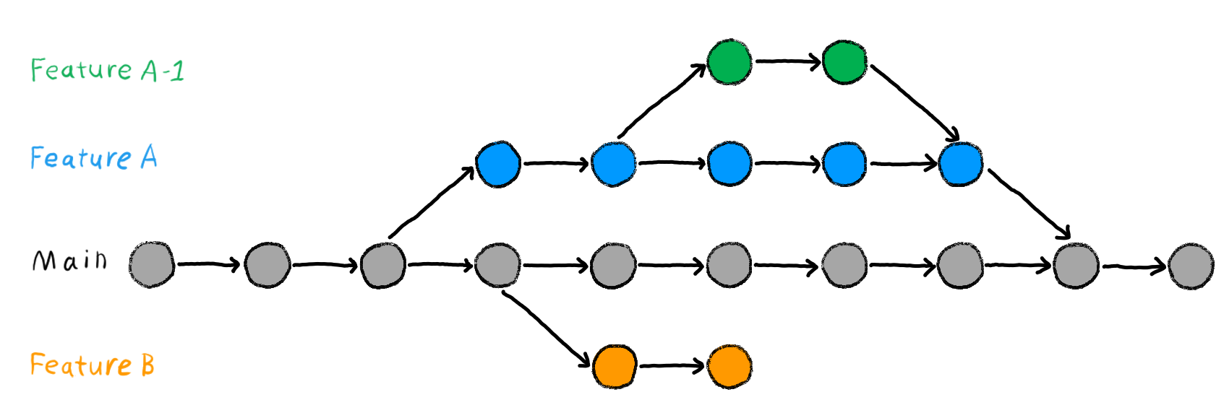
Merging
Merging combines the changes from one branch into another.
Typically, you merge a “feature” branch back into main once it’s complete and tested.
Switch to the branch that will receive the changes (e.g., main).
Run git merge <branch_name> to merge the feature branch into main.
Resolve any conflicts, if they occur.
Commit the merge (if needed).

Slide 13
Complete workflow example
Notes:
How to clone a remote repo
How to add a local remote to github
How to stage files
How to unstage files
How to commit files
How to restore committed files to staged
How to create a new branch
How to check which branches you have
How to switch to a new branch
How to merge a branch into main
How to delete a branch
How to delete a branch forcefully

Slide 14

Additional resources
git documentation:
https://git-scm.com/doc
GitHub Guides & Learning Lab:
github.com/skills
Atlassian git tutorials:
www.atlassian.com/git
Interactive branching game:
https://learngitbranching.js.org/

